Slide 1
PART I: PREPARING DATA FOR NEGOTIATIONS
© New Jersey School Boards Association
413 West State Street, Trenton, New Jersey 08618
All rights reserved. No part of this document may be reproduced in any form or by any means without permission in writing from NJSBA.

Slide 2
Costing Process
I. Identify All Economic Items
II. Ascertain Current Costs
III. Determine Anticipated
Increases
IV. Cost Out All Economic
Proposals
V. Repeat IV as negotiations result in
proposals and counterproposals
VI. Total Compensation Analysis
Steps:
Gather data
Devise formula
Do calculations

Slide 3
Comparing Apples to Apples

Slide 4
Data Gathering
1. SALARY BASE 2. NUMBER OF FTE TEACHERS 3. AVERAGE TEACHER SALARY 4. AVERAGE DAILY SALARY HOURLY RATE COST OF INCREMENT | $ _________ _________ $ _________ $ _________ $ _________ $ _________

Slide 5
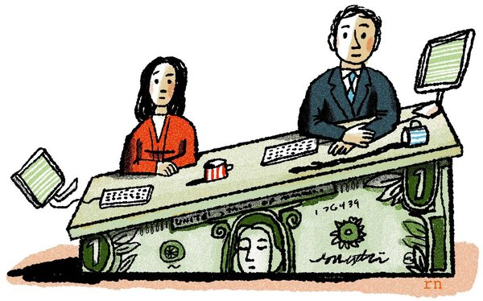
Base Year/Expiring Salary Guide
STEP | BA | MA
1 | 53,221 | 55,221
2 | 53,866 | 55,866
3 | 54,520 | 56,520
4 | 55,870 | 57,870
5 | 56,944 | 58,944
6 | 58,060 | 60,060
7 | 59,717 | 61,717
8 | 61,589 | 63,589
9 | 63,262 | 65,262
10 | 65,575 | 67,575
11 | 67,975 | 69,975
12 | 70,630 | 72,630
13 | 73,496 | 75,496
14 | 76,588 | 78,588
15 | 79,813 | 81,813
16 | 83,177 | 85,177
17 | 86,095 | 88,095

Slide 6
Scattergram
Step 1 2 3 4 5 6 17 | FTE 3.5 2.5 3.0 4.0 3.0 1.0 22.0 69.00 | BA 53,221 53,866 54,520 55,870 56,944 58,060 86,095 | Total $/Step $186,274 134,665 163,560 223,480 170,832 58,060 1,894,090 $4,392,060 | FTE 1.0 0.0 1.0 4.0 1.0 0.0 14.0 31.00 | MA 55,221 55,866 56,520 57,870 58,944 60,060 88,095 | Total $/Step $55,221 0 56,520 231,480 58,944 0 1,233,330 $2,107,940

Slide 7
Scattergram
Step 1 2 3 4 5 6 17 | FTE 3.5 2.5 3.0 4.0 3.0 1.0 22.0 69.00 | BA 53,221 53,866 54,520 55,870 56,944 58,060 86,095 | Total $/Step $186,274 134,665 163,560 223,480 170,832 58,060 1,894,090 4,392,060 | FTE 1.0 0.0 1.0 4.0 1.0 0.0 14.0 31.00 | MA 55,221 55,866 56,520 57,870 58,944 60,060 88,095 | Total $/Step $55,221 0 56,520 231,480 58,944 0 1,233,330 $2,107,940
SALARY BASE: $6,500,000 FTE= 100

Slide 8
Freezing the Scattergrams
Assume No Personnel Changes
Constant for Remainder of Negotiations
Provide to Union Early

Slide 9
Data Gathering
1. SALARY BASE 2. NUMBER OF FTE TEACHERS 3. AVERAGE TEACHER SALARY 4. AVERAGE DAILY SALARY 5. HOURLY RATE 6. COST OF INCREMENT | $ _________ _________ $ _________ $ _________ $ _________ $ _________
6,500,000
100

Slide 10
Calculating Average Salary Figures
Teacher’s Average Annual Salary:
$ 6,500,000 / 100 =
Teacher’s Average Daily Salary:
$ 65,000 / 185 =
Teacher’s Average Hourly Rate:
$ 351.30 / 7 =
$ 65,000
$ 351.35
$ 50.19

Slide 11
Data Gathering
1. SALARY BASE 2. NUMBER OF FTE TEACHERS 3. AVERAGE TEACHER SALARY 4. AVERAGE DAILY SALARY 5. HOURLY RATE 6. COST OF INCREMENT | $ _________ _________ $ _________ $ _________ $ _________ $ _________
6,500,000
100
65,000
351.35
50.19

Slide 12
Cost of Increment
Definition - Cost the Board will incur by advancing everyone who is not at maximum one step on the guide.
Why calculate?
All settlements should be Inclusive of Increment
How to calculate using scattergram?

Slide 13
Advancement
BASE YEAR |  | YEAR ONE
 |  | 1
1 | → | 2
2 | → | 3
3 | → | 4
4 | → | 5
5 | → | 6
6 | → | 7
7 | → | 8
8 | → | 9
9 | → | 10
10 | → | 11
11 | → | 12
12 | → | 13
13 | → | 14
14 | → | 15
15 | → | 16
16 | → | 17
17 | → | 17

Slide 14
Cost of Increment
$ 6,617,965 Year One
- 6,500,000 Base Year
$ 117,965
Total Cost of Increment
$ 117,965 / 6,500,000 = 1.81%

Slide 15
Data Gathering
1. SALARY BASE 2. NUMBER OF FTE TEACHERS 3. AVERAGE TEACHER SALARY 4. AVERAGE DAILY SALARY 5. HOURLY RATE 6. COST OF INCREMENT | $ _________ _________ $ _________ $ _________ $ _________ $ _________
6,500,000
100
65,000
351.35
50.19
117,965
Or 1.81%

Slide 16
Converting % Increases to Dollar Increases
Union Proposal: 4.5% increase in salary
Total $ Increase: Salary Base x Percent
$ 6,500,000 x .045 =
Average $ Increase: Total $ Increase / FTE
$ 292,500 / 100 =
$ 292,500
$ 2,925

Slide 17
Converting Across-the-Board Dollar Increases to Percentages
Board Proposal:
$1,000 across-the-board increase
Average $ Increase x # FTE
Total Salary Base
$ 1,000 x 100
$6,500,000
=
1.53%

Slide 18
Additional Salary Payments
LONGEVITY: Years of service in a district.
OFF-GUIDE: Staff members who are not on a salary guide but within the same group on a salary guide.

Slide 19
Questions?

