Slide 1
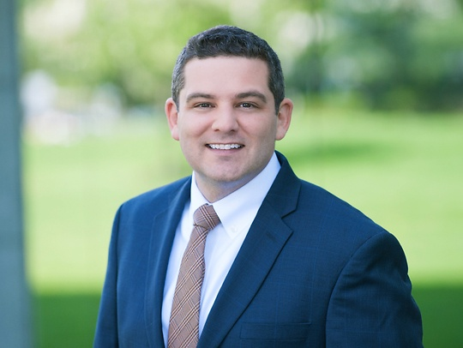
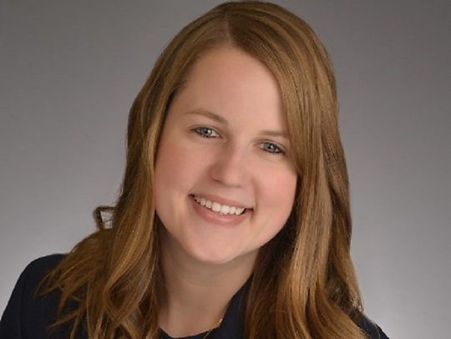
This is Going to Cost Money: Chapter 44 and Compensatory Education
William “Bill” Morlok, Esq.
Emily Schrank, Esq.

Slide 2
Format for Today
TWO VERY DIFFERENT TOPICS IN 50 MINUTES:
Chapter 44
Discussion
Compensatory Education
Discussion

Slide 3
What is the Council?
The Council on Local Mandates (“Council”) was formed in 1996 and was enacted by a Constitutional Amendment (Article VIII, Section II) and Statute (N.J.S.A. 52:13H-1, et seq.)
The Council reviews issues where the legislature imposes “unfunded mandates” on local government entities, including boards of education
This generally entails legislation without appropriate funding

Slide 4
Who is involved?
The Chairman of the Council is retired Judge John A. Sweeney
There are also seven other counsel members appointed by the “Governor, by the President of the Senate and the Senate Minority Leader, by the Speaker of the General Assembly and the Assembly Minority Leader, and by the Chief Justice of the New Jersey Supreme Court.” (https://www.state.nj.us/localmandates/)
Complaints may be filed by a county, municipality, or school board

Slide 5
Example
The legislature identifies a problem with lions, tigers, and bears breaking into schools. Legislation is enacted mandating schools to install animal proof fences and doors.
That legislation does not provide funding to offset the additional expenditures associated with installing the animal proof fences and doors.
The Board of Education could file a Complaint with the Council asserting that the legislation is an unconstitutional “unfunded mandate” and that it should be overturned.
The Board of Education could also ask for an injunction.

Slide 6
Council Facts
In the last 25 years, the Council has heard approximately 25 matters.
Council decisions are not appealable. Whatever the Council decides is final.
The Council may decide matters on the papers, allow for discovery, or have a hearing.
There are currently three matters pending before the Council, all of which were filed by Parker McCay on behalf of our clients, regarding Chapter 44.

Slide 7
What is Chapter 44
P.L. 2020, Chapter 44, requires school districts in New Jersey to offer a new health care plan.
Chapter 44 dictates all financial aspects of the plan, to include contribution percentages, contribution caps, and co-pays.
There is nothing left for school boards and their associations to negotiate to mitigate the financial impact of implementing Chapter 44.
Prior to Chapter 44, employee contribution rates to healthcare were based on a percentage of premium model.
Under Chapter 44, school district employee contribution rates toward health care benefits are now based on a percentage of salary model (with maximum caps on contributions), and employees are placed in a plan known as the New Jersey Educators Health Plan (NJEHP) or an equivalent plan.

Slide 8
The Cost of Chapter 44
Previously, employees contributed anywhere from 3% to 35%, whereas they now contribute in a range of 1.7% to 7.2%.
Many School Systems have seen the overall cost of healthcare go down (when you look at the overall cost for the Board and employees combined).
The problem with Chapter 44 is that the financial burden of the healthcare plans has drastically shifted towards the Board.
EXAMPLE: Previously, the Board was paying $4,000,000 and the employees were contributing $1,000,000, for a total cost of $5,000,000. Now, under Chapter 44, the Board is paying $4,400,000 and the employees are contributing $500,000, for a total of $4,900,000.
In this common situation, the overall cost of healthcare has gone down by $100,000, but instead of allowing for the Board to share in those savings, the Board’s cost has actually increased by $500,000.

Slide 9
Why Did the Legislature Do This?
It is widely believed that the legislature desires to have more individuals in the New Jersey Educators Health Plan (“NJEHP”).
The NJEHP plan has historically fluctuated significantly in costs from year to year when compared to traditional plans.
The NJEHP plan lowered their rate for medical coverage by 6.3% this year, yet some Districts have still had their overall healthcare costs increase.

Slide 10
What is Being Done?
Parker McCay has asked the Council to issue an injunction regarding Chapter 44, as it is clear that:
“(1) significant financial hardship to the claimant would result from compliance and
(2) there is a substantial likelihood that the statute or the rule or regulation is, in fact, an impermissible, unfunded State mandate.”
N.J.S.A. 52:13H-16; In re a Complaint filed by the Board of Education for the City of Clifton, Council on Local Mandates Decision (May 13, 1998).

Slide 11
Will the Legislature Fix it?
On February 18, 2021 the legislature circulated draft legislation that would have:
Limited who has to follow Chapter 44 (and/or delays implementation)
Allows for boards and associations to negotiate contribution levels
FOR UNKNOWN REASONS THAT LEGISLATION
WAS NEVER INTRODUCED
Instead, on March 4, 2021, the legislature introduced a new draft that exempted charter schools from Chapter 44, delayed implementation of Chapter 44, but curiously stripped boards of their ability to negotiate contribution levels.

Slide 12
What Happens Next
Does your district have to file?
What happens if Chapter 44 is struck down?

Slide 13
Compensatory Education
The Individuals with Disabilities Education Act (IDEA) does not define compensatory education BUT…
Goal is to remedy the knowledge and skill deficits that result when missed services are determined to have caused a denial of a FAPE

Slide 14
But we did everything…
No waiver of the IDEA during the COVID-19 pandemic
NJDOE allowed parents to opt for all virtual learning and required schools to provide an optimal education

Slide 15
The March 3, 2021 NJDOE Memo
Evaluate the need for compensatory education at the next IEP meeting and “determine the need, type, amount, frequency, duration, and location of compensatory education necessary to address lack of progress toward IEP goals and objectives resulting from missed services.”
Must be determined on an individual basis.

Slide 16
What Should We Review?
(1) Review formative and summative, formal and informal assessment data to determine progress toward each student’s IEP goals and objectives during the period of remote and hybrid instruction.
Did they meet their goals? If so, stop.

Slide 17
Missed Services
(2) What services were missed and what goals and objectives was the student expected to achieve, but did not achieve due to the absence of services?
Oddly, NJDOE has also told us that 1:1 makeup is not required.

Slide 18
Making an Offer
It could be tailored to the goals that were not achieved or limited to particular services
Consider summer or after school programming
“Additional learning loss and recovery services, such as accelerated learning programs, tutoring programs outside normal school hours, summer enrichment programs, and other opportunities designed to address learning loss that are available to all students.”

Slide 19
The Extra Services
How to include in an IEP without impacting “stay put.”
S3434 may impact compensatory education for students who are “aging out.”
Passed the Senate 36-1

Slide 20
Questions???
Thank you! Please feel free to contact us:
William “Bill” Morlok, Esq.
Cell: 267-784-3395
wmorlok@parkermccay.com
Emily Schrank, Esq.
Cell: 609-408-7647
eschrank@parkermccay.com

