Slide 1
New Jersey School Boards Association
Annual Spring Symposium
Presented by:
Rosa Cirianni
Communications Professional,
NJSBA Consultant
Chanta L. Jackson
Communications Officer/Registrar at Asbury Park School District,
Neptune Board of Education President
April 25, 2023
The Value of Transparency in School PR
© 2021 New Jersey School Boards Association, 413 W. State St., Trenton, NJ 08618. All right reserved. No part of this document may be reproduced in any for or by any means without permission in writing from NJSBA.

Slide 2
About your presenters
Rosa Cirianni is an experienced writer, editor and public relations consultant, who has worked in the NJSBA communications department and as a consultant in support of its marketing, communications and executive leadership. She is the owner and founder of Rose Write Strategies, LLC.
As an award-winning daily newspaper reporter, Rosa covered a vast array of topics from state government for The Associated Press, nuclear plant operations, elections, courts, environmental issues, crime and even a Southwest rodeo! While she specialized in government, she also covered several K-12 public school districts and higher education including Rutgers University, Arizona State University, Maricopa County College System and the Arizona Board of Regents.
Most recently, she has been working to support two statewide organizations: one is focused on STEM education and career pathways to forge a modern high-tech economy, and the other is an economic development agency charged with attracting jobs and investment.
Her strategic content landed her clients coverage on radio, TV, in both trade and major publications including the New York Times, on speaking panels, and online blogs — developing brand recognition and boosting sales. She has appeared on public access TV, has spoken to students from elementary schools to college, attended writing conferences throughout the nation, and judged annual professional journalism award contests.
She has served as a substitute public school teacher, a PTO executive board member, on a mayoral task force, and as an event co-director for a charitable fund in partnership with an area hospital. She is a former member of the New Jersey School Public Relations Association (NJSPRA) and Society of Professional Journalists (SPJ). Rosa strongly believes continual and clear communication always is the best strategy for every organization.
www.rosewritestrategies.com; LinkedIn: https://www.linkedin.com/in/rosacirianni/

Slide 3
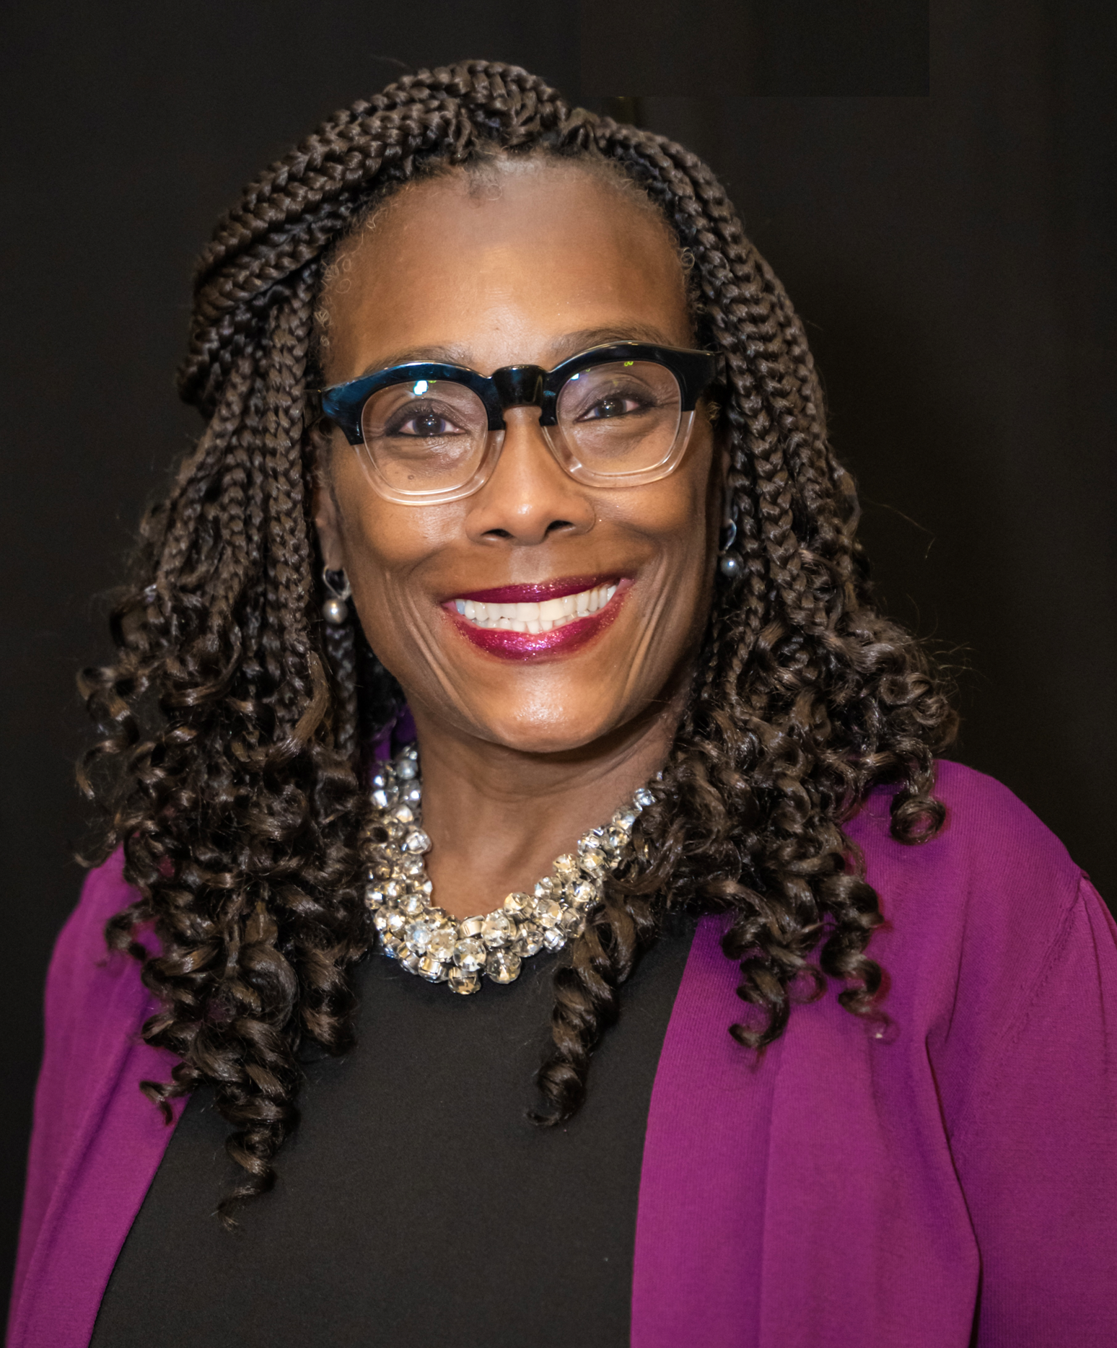
Chanta L. Jackson is an award-winning journalist with more than 25 years of experience. She is a graduate of the University of Maryland College Park and has done graduate studies at the Kellogg School of Business at Northwestern.
In the early stages of her career, she focused on broadcast journalist, but transitioned to print upon returning to New Jersey. She joined the Asbury Park Press as a reporter.
During her five-year stint, she held positions as a metro reporter, columnist and copy editor. Following her selection for a fellowship with the Maynard Institute for Journalism Education at the University of Arizona, she was recruited by The Star-Ledger as a copy editor. During her 15-year tenure at New Jersey’s largest newspaper, she served as a copy editor, deputy city editor, recruiter and multimedia publishing manager.
In 2013, she was forced to reinvent herself after The Ledger had its first layoff in 100 years. She chose to use her marketing and communication skills and entered the field of education. During her nine-year tenure at the Asbury Park School District, she has served as the chief branding and public information officer, who has successfully articulated the educational renaissance taking place.
In addition to her professional responsibilities, she currently volunteers with numerous organizations including: the Monmouth County Youth Services Commission for the past six years; treasurer of the Second Baptist Church in Long Branch for the past 19 years, president of the Neptune Township Board of Education and member for the past decade; and member of Delta Sigma Theta Sorority, Inc. for 38 years and Eastern Regional Journalist for the past six years. She is an alternate member of the NJSBA Board of Directors.
Chanta is a consummate volunteer with a servant’s heart.
Facebook: Chanta L. Jackson
Twitter: @chantaj4
Instagram: @mclj4
LinkedIn: https://www.linkedin.com/in/chantajackson/

Slide 4
Welcome
Course description
School officials must communicate with the public and engage people with different views. Explore how to target your audience, build credibility in your community and become the reliable go-to source for official information.
NJSBA Board Member Academy credit
.5
Qualified Purchasing Agent credit
1 QPA - Office Admin/Gen Duties

Slide 5
What Is Your Role?
Board of education member
Charter school member
Superintendent
School district administrator
School media relations/public affairs officer
Other/school district staff

Slide 6
What’s your role?
Are you part of your school district’s public relations strategy?
Yes
No
Somewhat

Slide 7
PUBLIC relations
Integrity PR is not marketing, advertising, exaggeration or “spinning” your own set of facts, especially when your district is a publicly-funded entity.
PR is earned attention. Public value or human interest; newsworthy item.
Key word: PUBLIC.
Motivation/self-reflection How does your school district RELATE to the public?
Accuracy Districts deal with the public and have to respect it by providing the truth – even when information is not favorable.
Transparency Not everything is top secret. All decisions can be potentially open to litigation. If you do not know the answer, that's OK. Just say so. Districts must follow state laws: Open Public Records Act and Open Public Meetings Act.
Responsiveness Example: “We’ll look into that and get back to you.” The rule of thumb is a response within 24 hours. Stonewalling can backfire.
Do no harm Be mindful of student/staff privacy. Consult your board attorney.

Slide 8
District PR rep duties
Serve the public, be accountable, tell the truth, correct mistakes and minimize harm.
Discern information. Understand how to develop and deliver content.
Speak on behalf of the district administration/school board and interface with the teachers, staff, students, parents, the public and the media.
Set the tone for safe, respectful, positive and effective messaging.
State the facts, not your personal opinions. Avoid conflicts of interest.
Establish a communication chain of command and make sure everyone is on board.
Build and protect district’s reputation and marketing identity.
Monitor district media coverage and what is happening in surrounding districts,
the state and the nation to spot education trends.
Work fast Issue statements and talking points in emergencies.

Slide 9
Are your communication
strategies effective?
What are your key reasons for communicating with your audiences?
How do you ensure your messages are communicated clearly and regularly?
When did you last review your strategies? What feedback did you receive?
Does your school board have a policy regarding external communications?
Notes:
Type responses in the chat

Slide 10
Is school PR necessary? Yes!
Be the leader in school communications for your community
Ensure efficient, effective and up-to-date communication channels
Deliver relevant, high-impact programs and information to maximize your audience engagement
Source: https://www.nspra.org/About-Us/Mission-Goals-Values

Slide 11
Communication strategies
Phone Calls/automated calls
Text Messages/push notifications
Emails
Newsletters (digital/paper)
Letters via mail
Website
Face-to-face (school events/BOE meetings)
Social media (Facebook, Twitter, Instagram, YouTube, Linkedin, etc.)
Video conferencing (Zoom, Google Meet, etc.)
Videos
*Translate materials to home language.

Slide 12
Changing landscape
Doing a good job is no longer good enough.
When telling your story, focus on the positives and not the controversial.
Share facts.
Words matter.
Refrain from using jargon or statistics without context or explaining.
Engage people wherever they are.

Slide 13
Social media tools
Facebook – mainly for parents; links to videos, pictures with captions, announcements, surveys and results. Broadcast live from an assembly, etc.
Twitter – quick announcements, administrators, pictures, emergencies.
Instagram – reaches more students.
YouTube – performances, graduations, presentations.
TikTok – creative avenue, entertaining content intended to go viral.
Traditional tools – newsletters, e-blasts, televised board meetings on local access channel, post agenda and minutes on district website, attend parent-teacher meetings, text messaging traffic/emergency alerts.
Form BOE liaisons – create connections with each school, municipal governing body and other relevant community organizations to report concerns and opportunities to full board.
Other – share student and teacher blogs/podcasts/student newspapers.

Slide 14
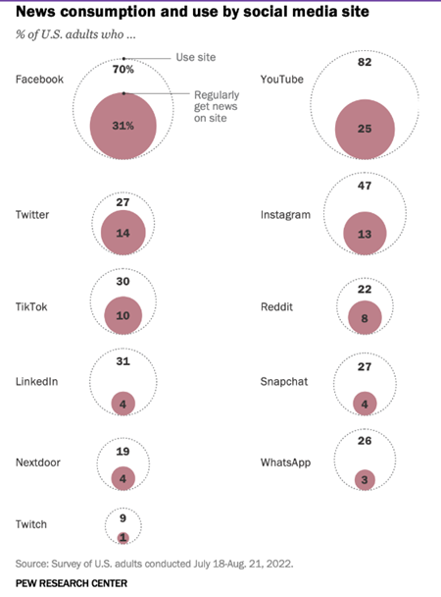
Social media as news source

Slide 15
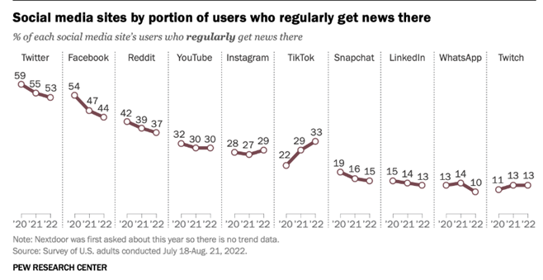
Social media as news source

Slide 16
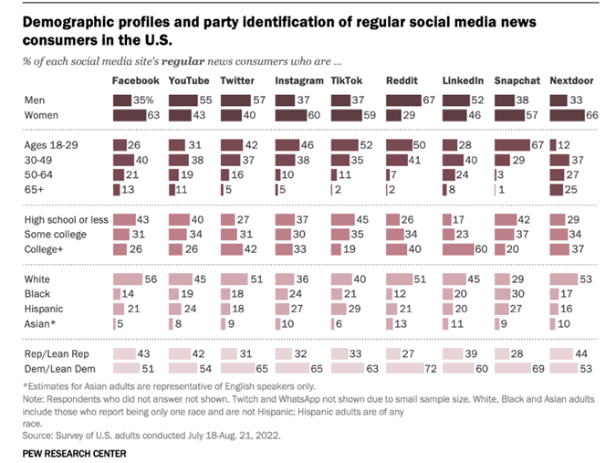
Social media as news source

Slide 17
Tips to navigate social media
Communicate in a conversational tone.
Always use proper grammar.
Words matter.
Always take the high road.
Create an official district account on each platform.
Take advantage of content aggregators that update social media sites simultaneously. (i.e. Hootsuite, Buffer, Curator, SocialMediaWall, Netvibes, etc.)

Slide 18
Warning: Social media risks
Once you hold a public office, elected or appointed, your personal and official lives become one.
Social media posts are not necessarily protected under the First Amendment: https://www.njsba.org/news-publications/school-board-notes/april-30-2019-vol-xlii-no-38/social-media-posts-are-not-necessarily-protected-by-first-amendment/
You are held to different standards in the court of public opinion – and legally and ethically under the New Jersey School Ethics Commission, which has censured numerous school officials.
What you and your family members post online and say in public can negatively impact/reflect on your school board and district.

Slide 19
If your public school district does not have an official public relations/media relations person responsible for disseminating information, you are not alone.

Slide 20
Current landscape
About 16% of New Jersey public school districts have a dedicated person to handle their school communications, including social media.
Source: New Jersey School Public Relations Association, 2021

Slide 21
School PR hiring guidelines
As long as 50 percent of the person’s role includes other job responsibilities, according to state law.
STATUTE EXCERPT: Public relations services are incorporated into the duties of the superintendent, SBA, and/or other staff position(s) and are not provided by a dedicated public relations staff position or contracted service provider. Public relations functions as defined in (c)14i and ii below should not comprise more than 50 percent of the duties of any one staff position.
https://www.state.nj.us/education/code/current/title6a/chap23a.pdf

Slide 22
School PR spending regulations - N.J.
Boards of education should adopt the following to minimize the cost of public relations as defined in N.J.A.C. 6A:23A-9.3(c) 14, in accordance with N.J.A.C. 6A:23A-5.2.
Annual budget limit: School boards must establish an annual limit for PR costs in their budgets and notify the board if fees exceed that amount.
Cost-efficient: Publications produced and distributed in the most cost-efficient manner.
Election rules: School districts cannot distribute, via mass mailings or other means publications that include the pictures of any members of the school board within 90 days before any election for any elected office.
PR regulations: Booths at statewide conferences, marketing activities and celebrations for opening schools and community events, and TV productions not part of the instructional program or that do not provide information about district or school board operations to the public, may be considered excessive and are prohibited.
Referendum standards: Activities to advance a particular position on school elections or any referenda are prohibited.

Slide 23
Where to post your job listing
Journalismjobs.com
NSPRA.org
Journalismnext.com
PRSANJ.org
Mediabistro.com
PRSA.org
IABC.com
NJSPRA.com *training/networking offered
LinkedIn and your personal professional network
Where can superintendents or their designee obtain training?
PRSA.org offers seminars/webinars as do many of the organizations listed.
NJSBA provides year-round seminars and annual events including its PR Forum, Spring Symposium, and fall Workshop conference.

Slide 24
Sample job titles for this work
Public information officer (PIO)
Communications director
Communications specialist (junior)
Public affairs officer
Media relations officer

Slide 25
Best practices
Confidentiality trust and respect your network.
Constructive input from your community.
Timely information. Use data, facts, audit findings and surveys results.
Frequently delivered information across multiple channels (video, online and print).
Cordial relationship with the press.
Sense of trust/credibility.
Well-informed parents.
Amazing stories about your students and educator achievements.
Communication using cost-efficient delivery tools.
Handling crisis situations emergencies, tragic incidents, natural disasters, etc.
Networking with local residents and community groups, businesses, parent-teacher groups, principals, union leaders, clergy, and law enforcement to build relationships. Municipal, county and state officials, emergency services, health officers, area hospital leaders, etc.
Staying in the know keep up with decisions by other districts in your area and state, and national education news.

Slide 26
In closing
A successful school district PR campaign can:
Change negative perceptions and help the public view your schools in a different light. (Move forward from a bad incident that may have occurred years ago).
Attract top talent to your administration team, classrooms and athletics.
Make your community feel welcomed and engaged.
Create emotional connections with your teachers, staff, students, alumni, parents and the public.
Protect your district’s reputation with the community, which funds ballot initiatives, educators’ goals and students’ dreams.

Slide 27
RESOURCES

Slide 28
New Jersey Open Public Records Act - OPRA
The New Jersey Open Public Records Act (OPRA requests) defines “government record” as printed records, tape recordings, microfilm, books, maps, photographs and electronically stored records and information.
This includes emails, text messages, social media records, and data stored in databases.
Any material posted an official district social media platform, including comments, are considered public records and need to be retained.
This is true even for any profane/abusive comments that may be deleted. Records should be kept.
RESOURCE: N.J.S.A.47:1A-1 https://www.nj.gov/opra/
IMPORTANT NOTE: All electronic content is a matter of official public record and must be maintained. Posts only can be deleted for certain reasons such as profanity, verbal abuse/threats. It would be wise to screenshot those items before removing and keeping a record should someone request inspection or copies via an OPRA request.

Slide 29
New Jersey Sunshine Law – Open Public Meetings Act (OPMA)
Requires public bodies to provide 48 hours public notice of all meetings, the right to attend those meetings and provide minutes
Goes into effect when a quorum is present, whether in person, by phone or other means of electronic communication
School boards are required to set aside a portion of every meeting for public comment
Written policies may be adopted regarding time limits and sign-in procedures
School boards are not required to respond to questions and cannot censor speech
A public body cannot prohibit comments based on subject matter as long as the comments relate to any issue “that a member of the public feels may be of concern to the residents of the municipality or school district”
Notice of an emergency meeting must include an agenda
Closed sessions are only permitted under strict guidelines
Lawsuits can be filed in Superior Court of New Jersey for alleged violations
(Source: American Civil Liberties Union of New Jersey, The Sunshine Law)

